Slide 1
St. Louis Central Corridor West Building Permits
Monthly Report: June 2020

Slide 2
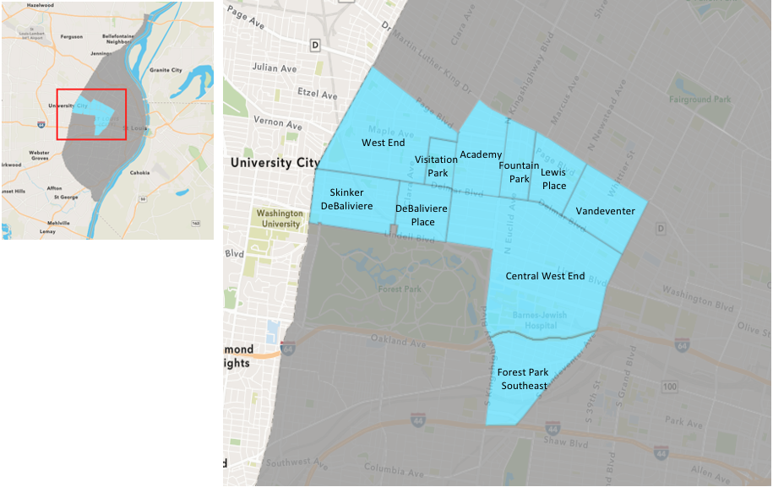
St. Louis Neighborhood Spatial Reference

Slide 3
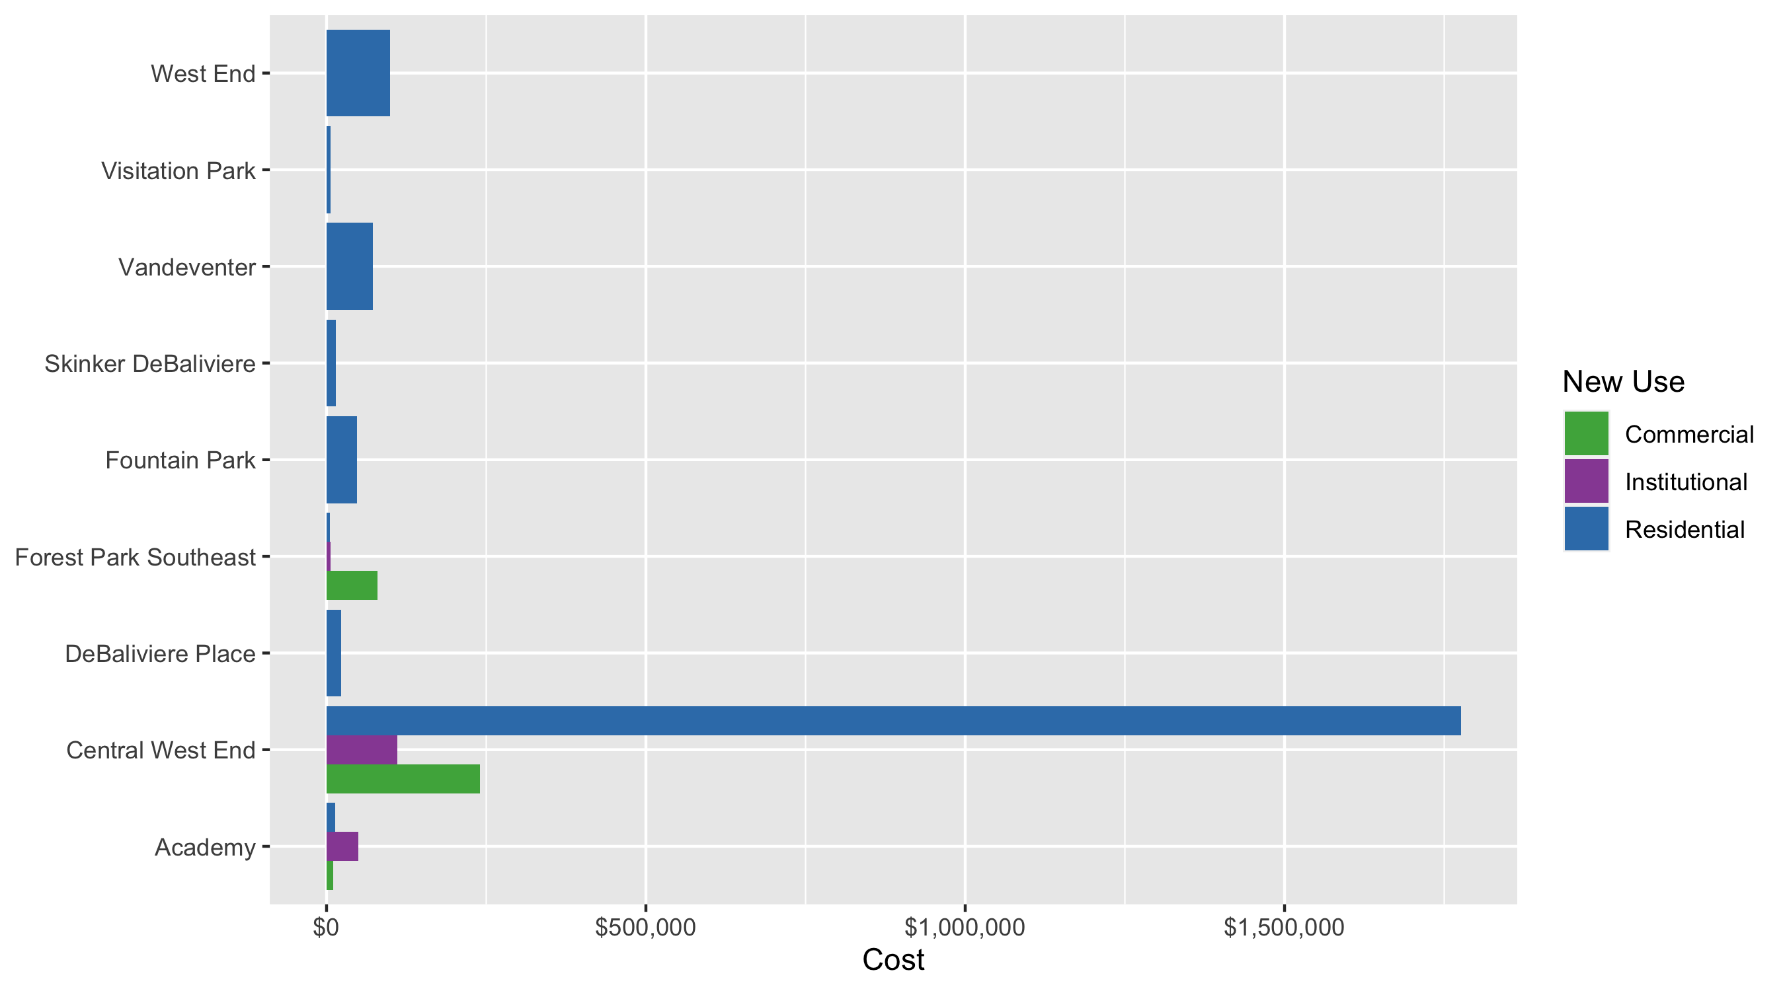
Neighborhood Summary: Average Building Permit Cost

Slide 4
Neighborhood Summary
June 2020 | June 2020 | June 2020 | June 2020
Neighborhood | Average Cost | # of Permits | Total Value of Permits
Academy | $16,967 | 9 | $152,700
Central West End | $1,019,484 | 43 | $43,837,817
DeBaliviere Place | $22,434 | 6 | $134,607
Forest Park Southeast | $20,480 | 10 | $204,800
Fountain Park | $47,500 | 2 | $95,000
Lewis Place | $0 | 0 | $0
Skinker DeBaliviere | $14,961 | 11 | $164,574
Vandeventer | $72,500 | 2 | $145,000
Visitation Park | $6,756 | 2 | $13,511
West End | $99,000 | 5 | $495,000
Last 6 Months | Last 6 Months | Last 6 Months | Last 6 Months
Neighborhood | Average Cost | # of Permits | Total Value of Permits
Academy | $53,037 | 23 | $1,219,850
Central West End | $607,221 | 214 | $129,945,284
DeBaliviere Place | $866,827 | 25 | $21,670,666
Forest Park Southeast | $112,451 | 56 | $6,297,250
Fountain Park | $58,357 | 7 | $408,500
Lewis Place | $800 | 4 | $3,200
Skinker DeBaliviere | $6,024,898 | 66 | $397,643,257
Vandeventer | $48,135 | 8 | $385,077
Visitation Park | $9,170 | 3 | $27,511
West End | $644,725 | 34 | $21,920,646

Slide 5
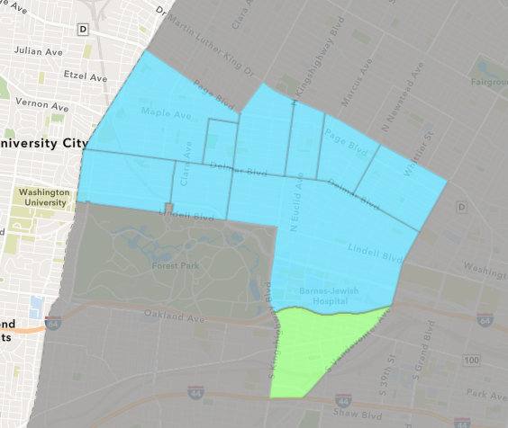
Forest Park Southeast
June 2020 Neighborhood Cost Breakdown
Mean: $20,480
Median: $5,250
Range: $200 - $150,000

Slide 6
Forest Park Southeast: Summary Notes
10 building permits in June 2020
-9.09% change compared to June 2019 (11 total building permits)
$20,480: Average building permit cost in June 2020
-69.10% change compared to June 2019 ($66,273)
56 total building permits in 2020
-37.08% change YTD compared to this time in 2019 (89 total building permits)
$112,451: YTD average building permit cost in 2020
-14.39% change YTD compared to this time in 2019 ($131,357)

Slide 7
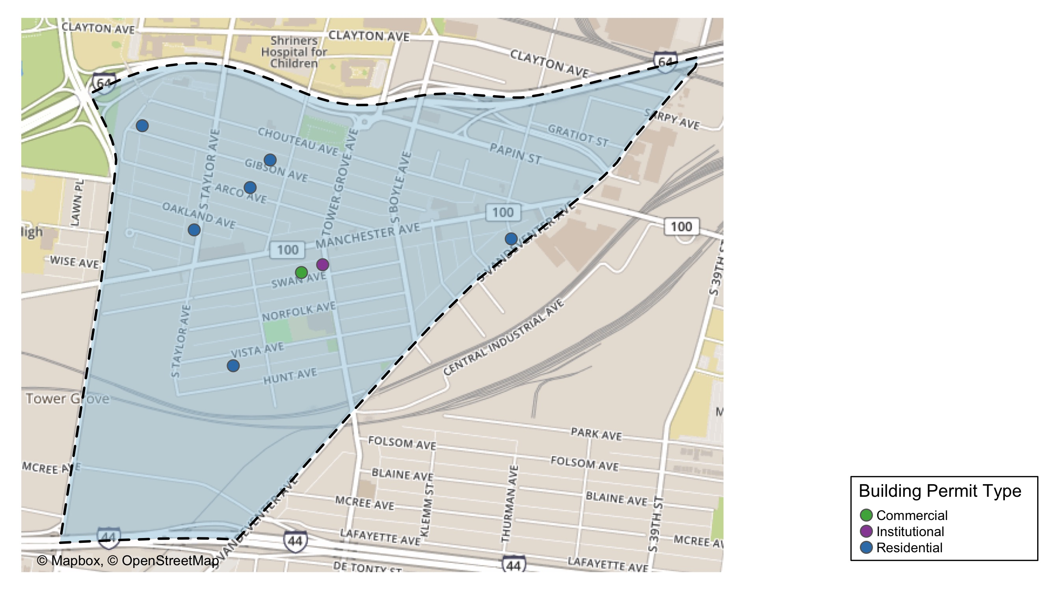
Forest Park Southeast

Slide 8
Neighborhood Summary
June 2020 | June 2020 | June 2020 | June 2020
Permit Use | Average Cost | # of Permits | Total Value of Permits
Commercial | $80,000 | 2 | $160,000
Industrial | $0 | 0 | $0
Institutional | $5,750 | 2 | $11,500
Residential | $5,550 | 6 | $33,300
Last 6 Months | Last 6 Months | Last 6 Months | Last 6 Months
Permit Use | Average Cost | # of Permits | Total Value of Permits
Commercial | $297,820 | 15 | $4,467,300
Industrial | $0 | 0 | $0
Institutional | $58,740 | 6 | $352,439
Residential | $42,215 | 35 | $1,477,511

Slide 9
Forest Park Southeast Individual Permit Breakdown
Owner | New Use | Cost | address
GREATER GOODS HOLDING LLC | Institutional | $9,000 | 4427 CHOUTEAU AV
FARRELL, MYLES | Residential | $200 | 4401 ARCO AV
TISOTO, JEFFREY & LYNNE | Residential | $20,000 | 4529 GIBSON AV
PARK SOUTH PROPERTIES LLC | Institutional | $2,500 | 4366 MANCHESTER AV
PATTERSON, EUDORA | Residential | $1,500 | 4418 CHOUTEAU AV
WILSON, SARAH & MARK MANGAPORA | Residential | $8,000 | 4544-46 OAKLAND AV
DOGWOOD STL LLC | Commercial | $10,000 | 4308 MANCHESTER AV
RICH, TOM & WILLIAM DONAHUE | Residential | $1,600 | 4481 VISTA AV
GROVE GARDENS LLC | Residential | $2,000 | 1327 S VANDEVENTER AV
4014 CHOUTEAU INVESTMENTS LLC | Commercial | $150,000 | 4014 CHOUTEAU AV

Slide 10
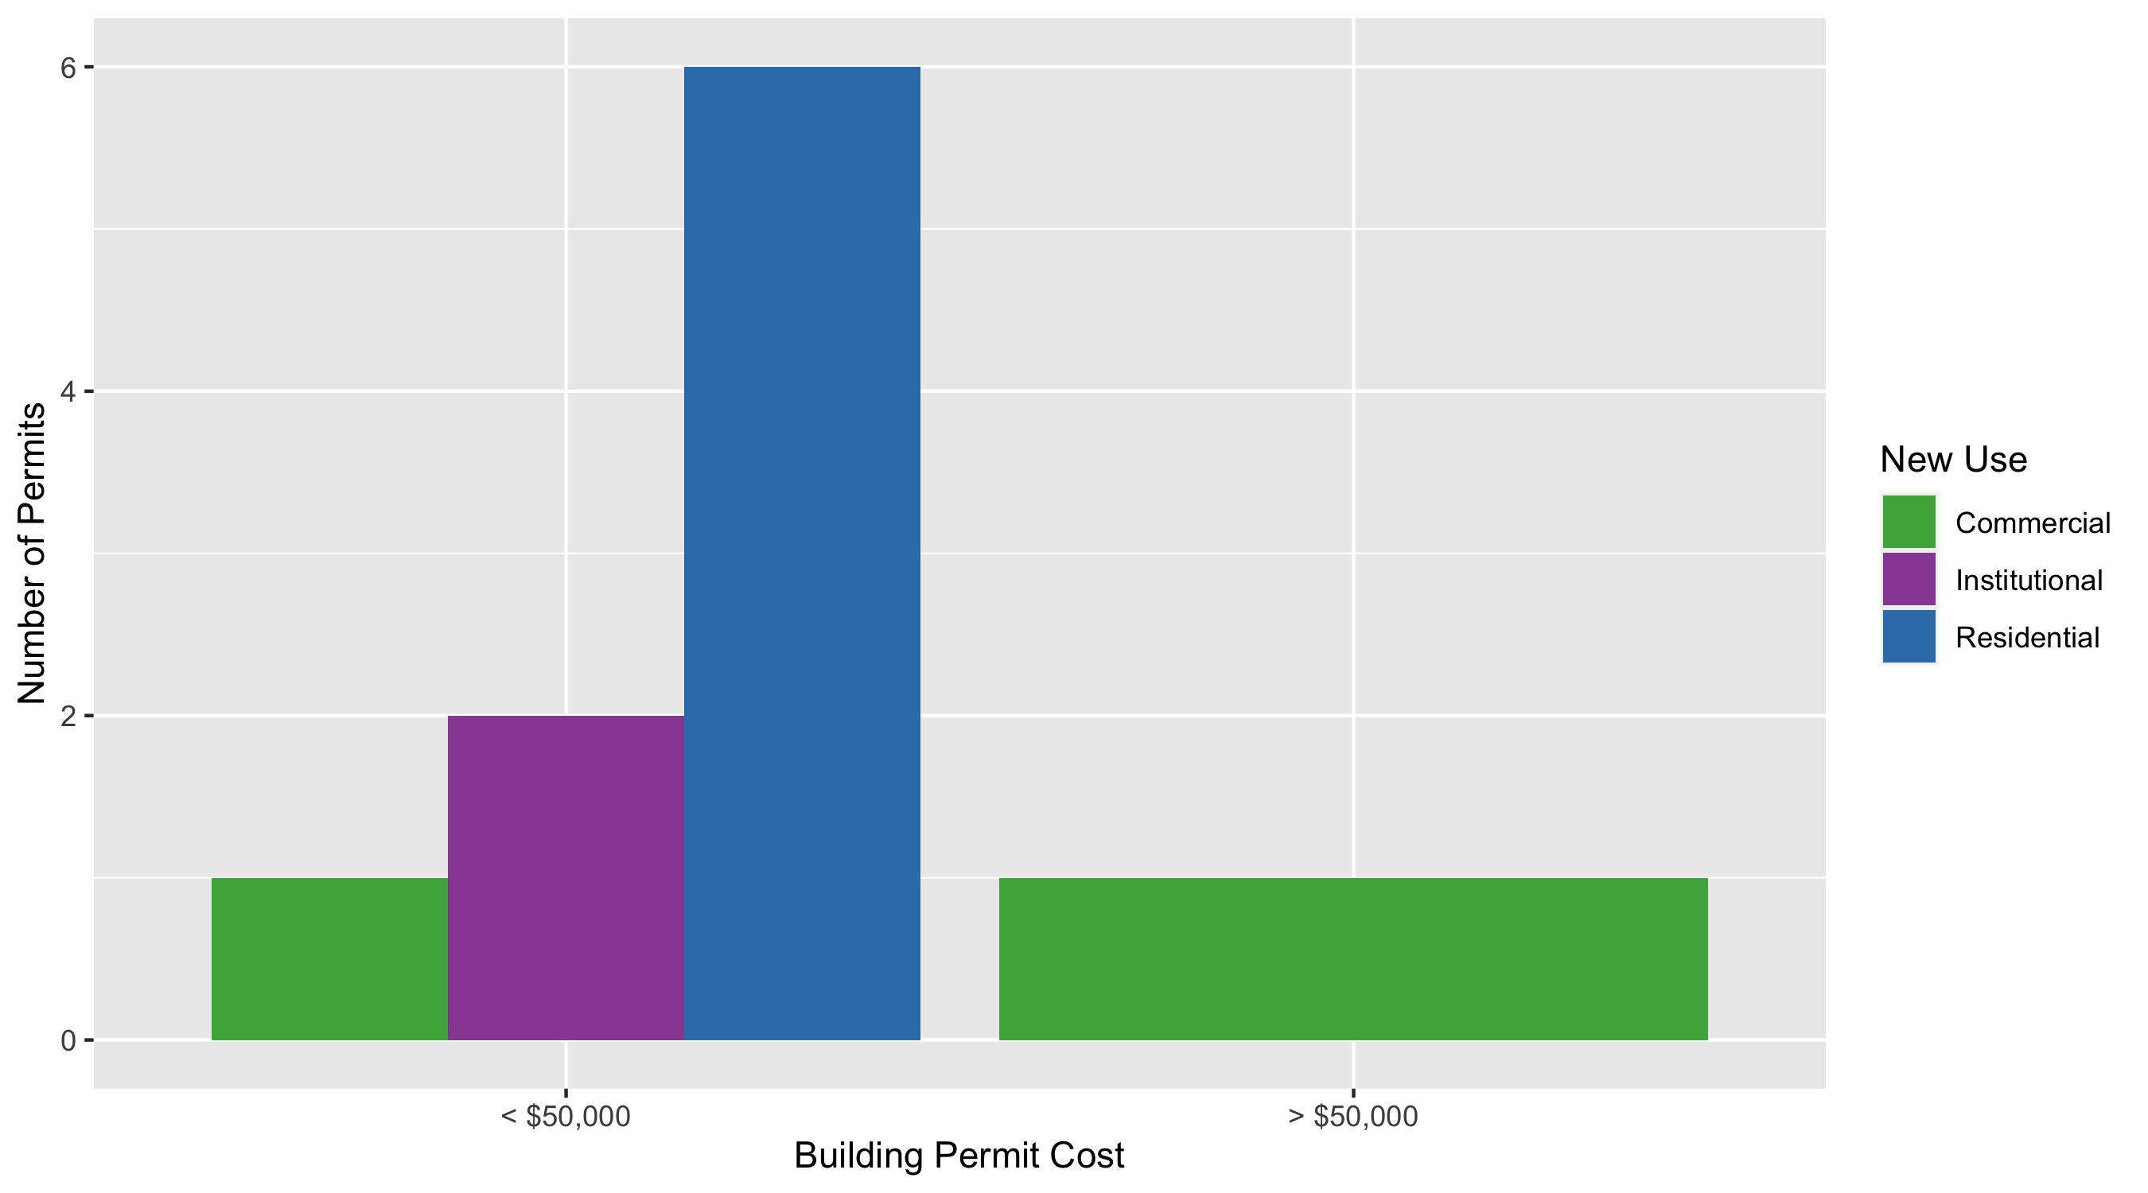
Forest Park Southeast Permit Cost Breakdown

Slide 11
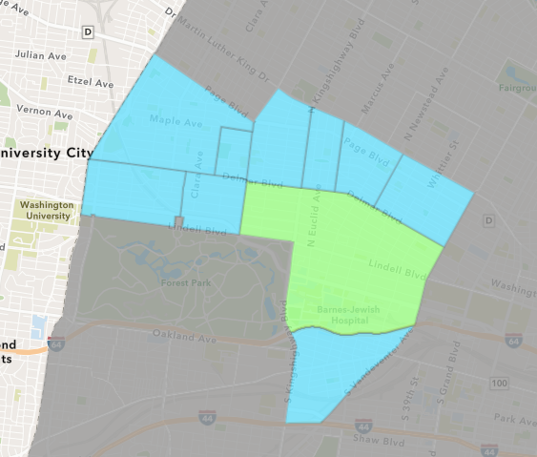
Central West End
June 2020 Neighborhood Cost Breakdown
Mean: $1,019,484
Median: $17,360
Range: $500 - $40,000,000

Slide 12
Central West End: Summary Notes
43 building permits in June 2020
2.38% change compared to June 2019 (42 total building permits)
$1,019,484: Average building permit cost in June 2020
193.69% change compared to June 2019 ($347,131)
214 total building permits in 2020
-7.36% change YTD compared to this time in 2019 (231 total building permits)
$607,221: YTD average building permit cost in 2020
138.06% change YTD compared to this time in 2019 ($255,076)

Slide 13
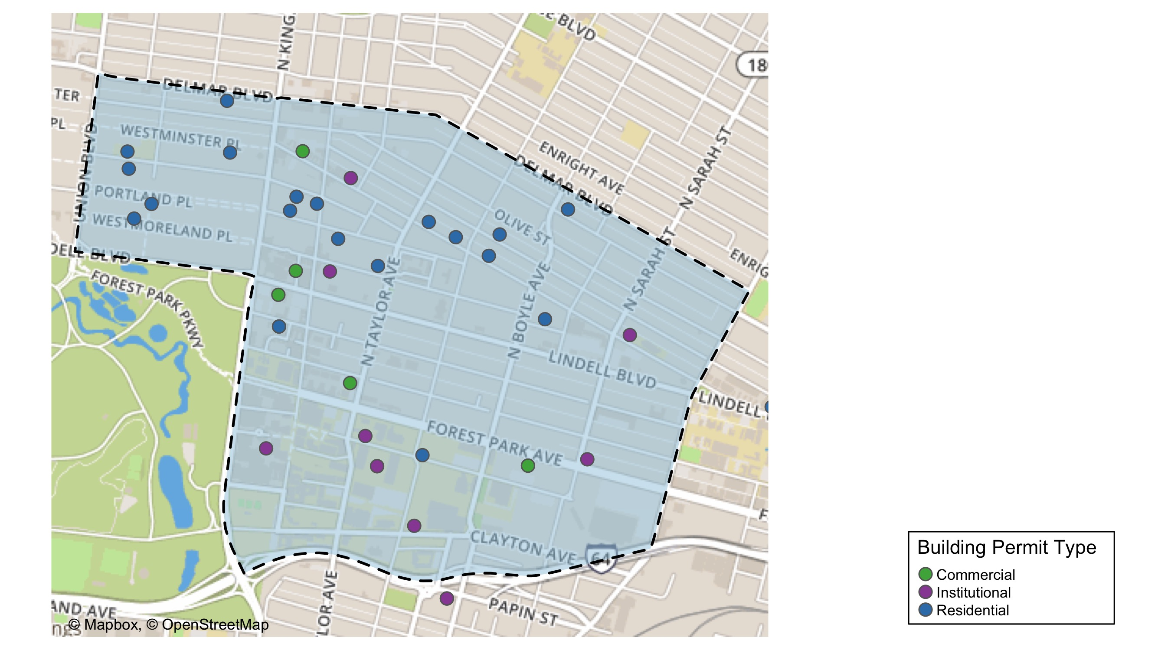
Central West End

Slide 14
Central West End
June 2020 | June 2020 | June 2020 | June 2020
Permit Use | Average Cost | # of Permits | Total Value of Permits
Commercial | $239,727 | 6 | $1,438,360
Industrial | $0 | 0 | $0
Institutional | $110,826 | 14 | $1,551,567
Residential | $1,775,995 | 23 | $40,847,890
Last 6 Months | Last 6 Months | Last 6 Months | Last 6 Months
Permit Use | Average Cost | # of Permits | Total Value of Permits
Commercial | $582,268 | 32 | $18,632,579
Industrial | $20,838 | 2 | $41,676
Institutional | $942,248 | 70 | $65,957,380
Residential | $411,942 | 110 | $45,313,649

Slide 15
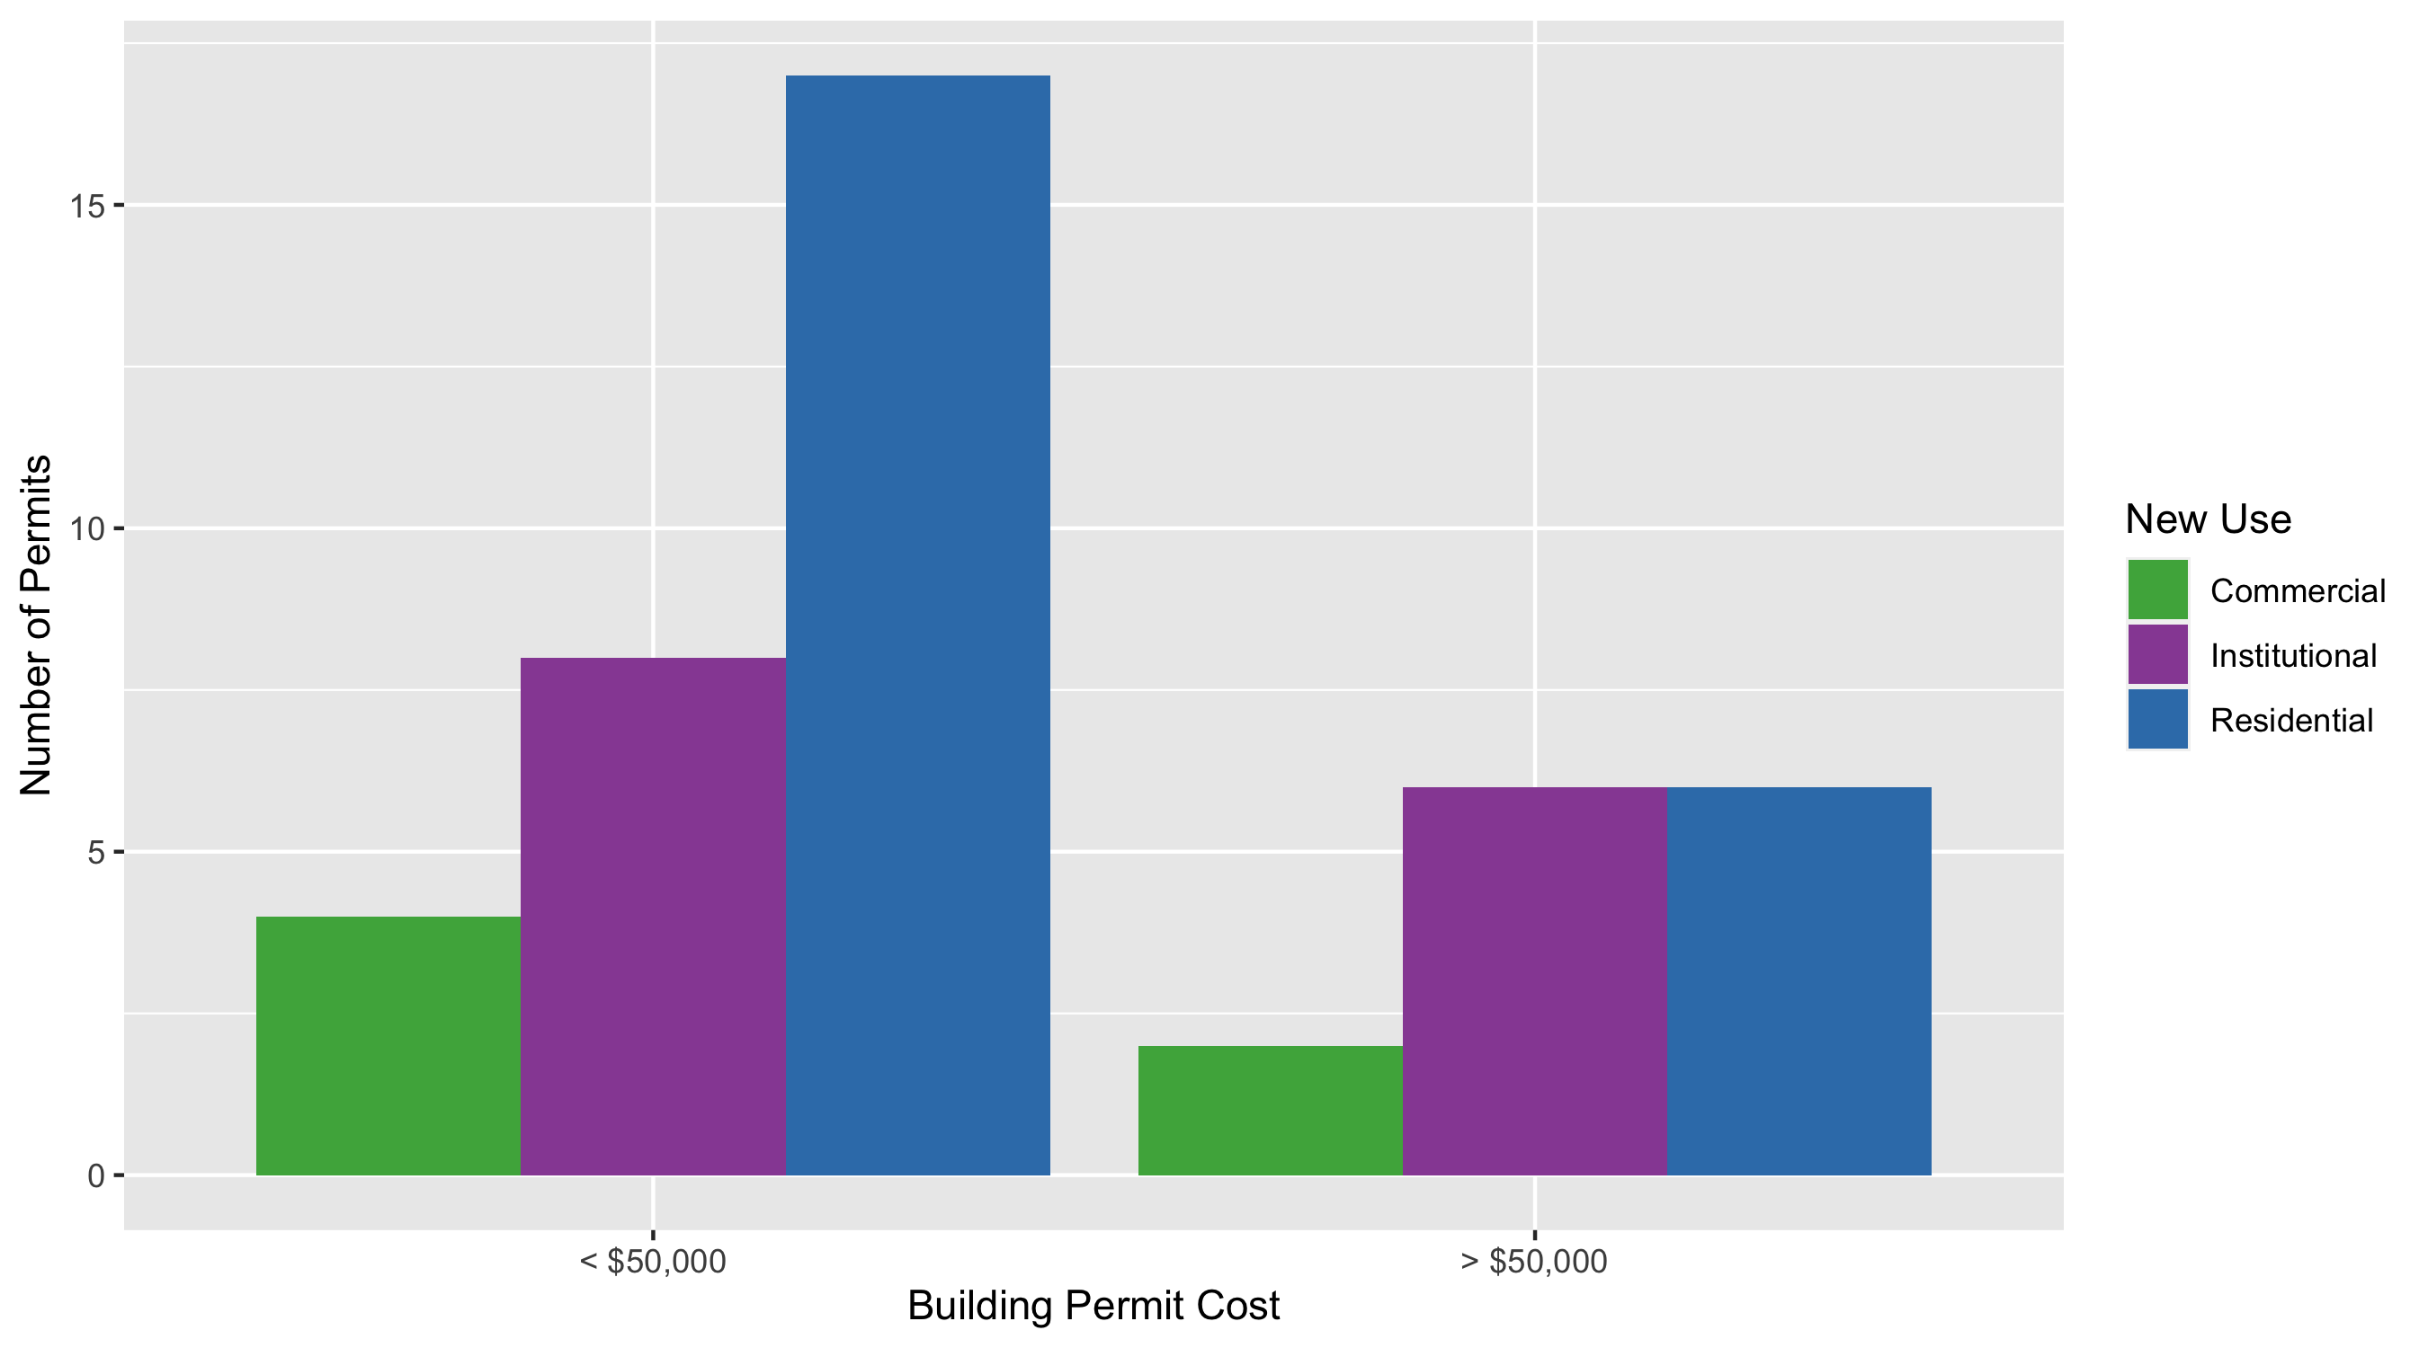
Cental West End Permit Cost Breakdown

Slide 16
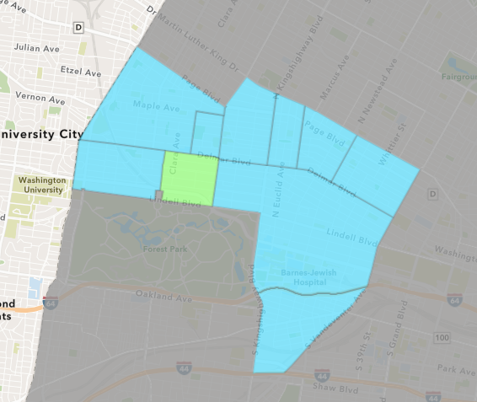
DeBaliviere Place
June 2020 Neighborhood Cost Breakdown
Mean: $22,434
Median: $16,000
Range: $600 - $68,095

Slide 17
DeBaliviere Place: Summary Notes
6 building permits in June 2020
0.00% change compared to June 2019 (6 total building permits)
$22,434: Average building permit cost in June 2020
-31.47% change compared to June 2019 ($32,739)
25 total building permits in 2020
-21.88% change YTD compared to this time in 2019 (32 total building permits)
$866,827: YTD average building permit cost in 2020
1344.64% change YTD compared to this time in 2019 ($60,003)

Slide 18
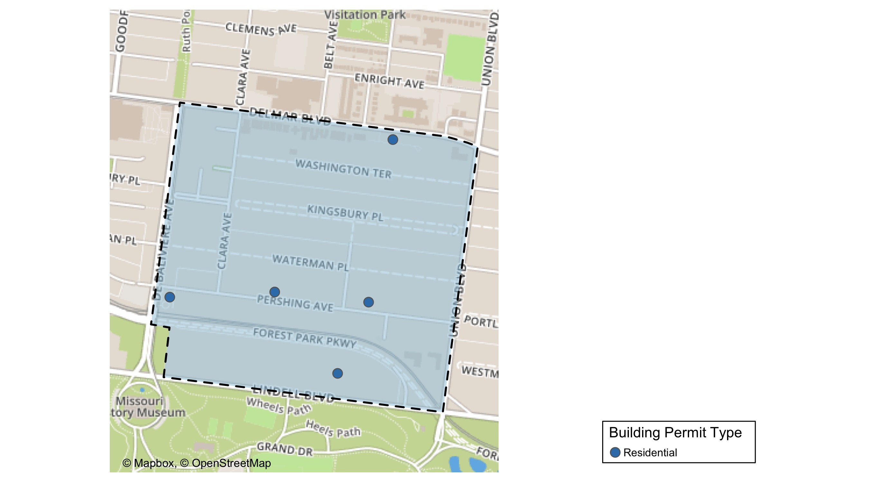
DeBaliviere Place

Slide 19
DeBaliviere Place
June 2020 | June 2020 | June 2020 | June 2020
Permit Use | Average Cost | # of Permits | Total Value of Permits
Commercial | $0 | 0 | $0
Industrial | $0 | 0 | $0
Institutional | $0 | 0 | $0
Residential | $22,434 | 6 | $134,607
Last 6 Months | Last 6 Months | Last 6 Months | Last 6 Months
Permit Use | Average Cost | # of Permits | Total Value of Permits
Commercial | $25,000 | 1 | $25,000
Industrial | $0 | 0 | $0
Institutional | $0 | 0 | $0
Residential | $901,903 | 24 | $21,645,666

Slide 20
DeBaliviere Place Individual Permit Breakdown
Owner | New Use | Cost | Address
WILLIAMS, CHRISTOPHER & BROOKE | Residential | $68,095 | 9 KINGSBURY PL
BRATIC, ROCKO & SANDRA | Residential | $25,000 | 9 WASHINGTON TER
WATERMAN-PERSHING CONDO PLAT 4 | Residential | $28,912 | 5560 WATERMAN BLVD
MEINERS, EILEEN & SAMUEL | Residential | $7,000 | 5625 LINDELL BLVD
LAUBI, DAVID S | Residential | $600 | 5349 PERSHING AV
JONES, COURTNEY A & TRITOBIA Q | Residential | $5,000 | 5357 LINDELL BLVD

Slide 21
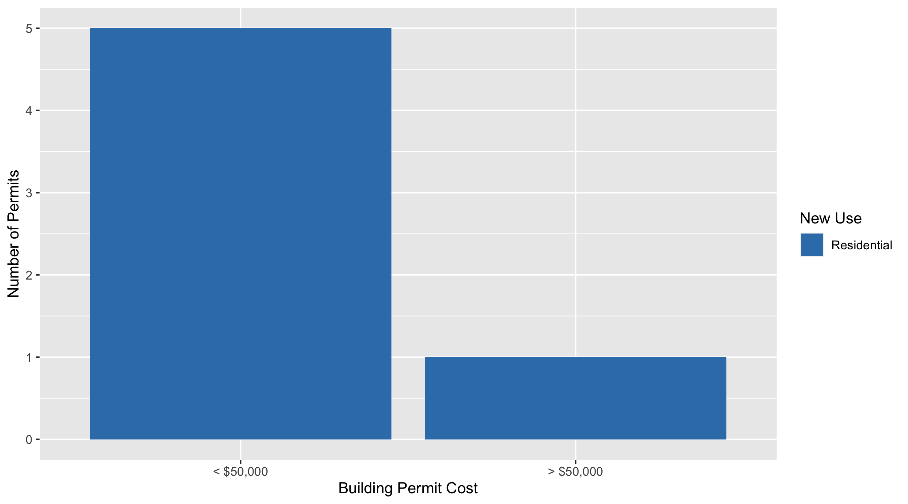
DeBaliviere Place Permit Cost Breakdown

Slide 22
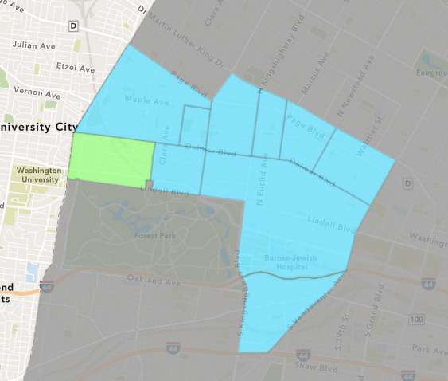
Skinker DeBaliviere
June 2020 Neighborhood Cost Breakdown
Mean: $14,961
Median: $9,500
Range: $1,000 - $56,500

Slide 23
Skinker DeBaliviere: Summary Notes
11 building permits in June 2020
120.00% change compared to June 2019 (5 total building permits)
$14,961: Average building permit cost in June 2020
14.73% change compared to June 2019 ($13,041)
66 total building permits in 2020
112.90% change YTD compared to this time in 2019 (31 total building permits)
$6,024,898: YTD average building permit cost in 2020
38408.70% change YTD compared to this time in 2019 ($15,646)

Slide 24
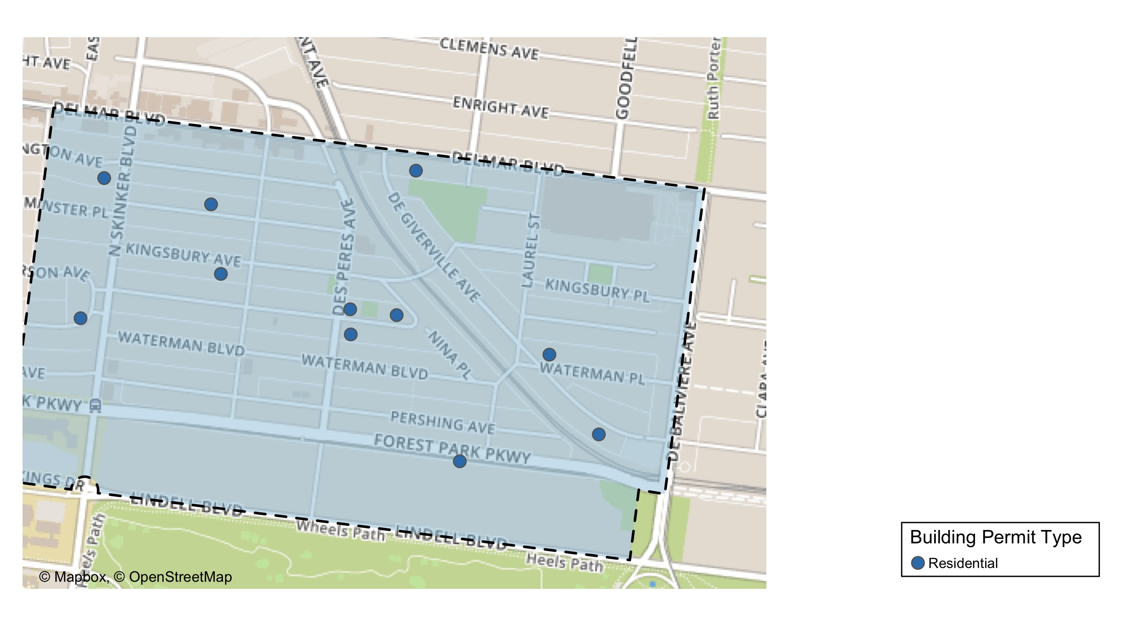
Skinker DeBaliviere

Slide 25
Skinker DeBaliviere
June 2020 | June 2020 | June 2020 | June 2020
Permit Use | Average Cost | # of Permits | Total Value of Permits
Commercial | $0 | 0 | $0
Industrial | $0 | 0 | $0
Institutional | $0 | 0 | $0
Residential | $14,961 | 11 | $164,574
Last 6 Months | Last 6 Months | Last 6 Months | Last 6 Months
Permit Use | Average Cost | # of Permits | Total Value of Permits
Commercial | $56,185,283 | 7 | $393,296,978
Industrial | $0 | 0 | $0
Institutional | $10,000 | 1 | $10,000
Residential | $74,763 | 58 | $4,336,279

Slide 26
Skinker DeBaliviere Individual Permit Breakdown
Owner | New Use | Cost | Address
HOGAN, JOSEPH M & ELIZABETH | Residential | $16,452 | 6186 KINGSBURY AV
MCWILLIAMS, SEAN | Residential | $33,765 | 6144 WASHINGTON AV
WELLS, JOHN DRYDEN & | Residential | $1,000 | 5745 DEGIVERVILLE AV
GANNON, MARILYN LAMONT TRS | Residential | $56,500 | 5763 LINDELL BLVD
LEWIS, STEPHANIE R | Residential | $18,000 | 5903 DEGIVERVILLE AV
HARRISON, TIMOTHY & MEGAN | Residential | $1,000 | 5745 WATERMAN BLVD
BRISCO, BETHANY A & ANDREW F CAWOOD | Residential | $5,000 | 6223 WASHINGTON AV
RHODES, AMANDA JEANNE SOPHIA | Residential | $9,500 | 5921 PERSHING AV
TEATER, DANIEL & ARIELLA | Residential | $2,000 | 5947 WATERMAN BLVD
VON ROHN, ENRIQUE & MELISSA P | Residential | $3,000 | 5950 KINGSBURY AV
GIAIMO, CHRISTOPHER & | Residential | $18,357 | 6210 WESTMINSTER PL

Slide 27
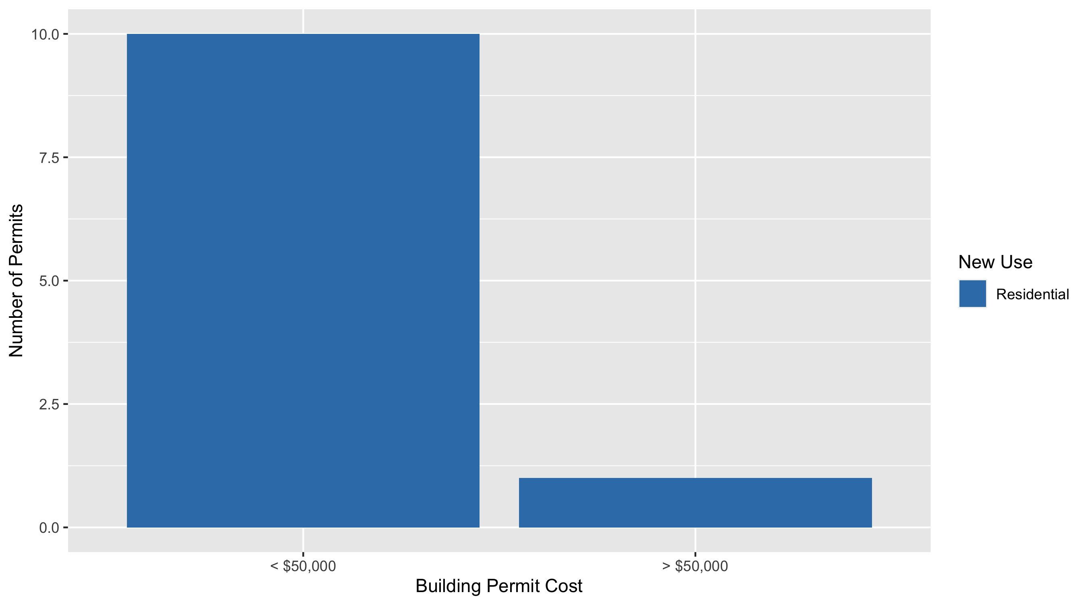
Skinker DeBaliviere Permit Cost Breakdown

Slide 28
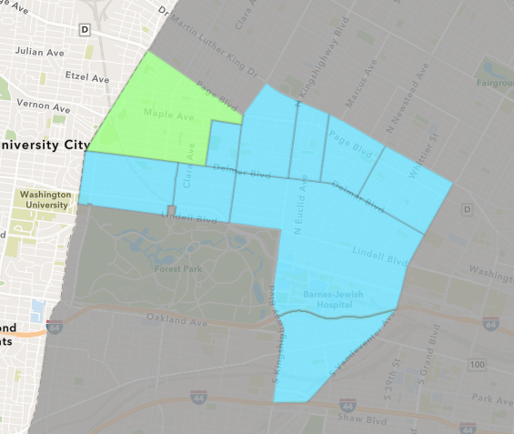
West End
June 2020 Neighborhood Cost Breakdown
Mean: $99,000
Median: $18,000
Range: $8,000 - $325,000

Slide 29
West End: Summary Notes
5 building permits in June 2020
66.67% change compared to June 2019 (3 total building permits)
$99,000: Average building permit cost in June 2020
1020.75% change compared to June 2019 ($8,833)
34 total building permits in 2020
100.00% change YTD compared to this time in 2019 (17 total building permits)
$644,725: YTD average building permit cost in 2020
394.22% change YTD compared to this time in 2019 ($130,453)

Slide 30
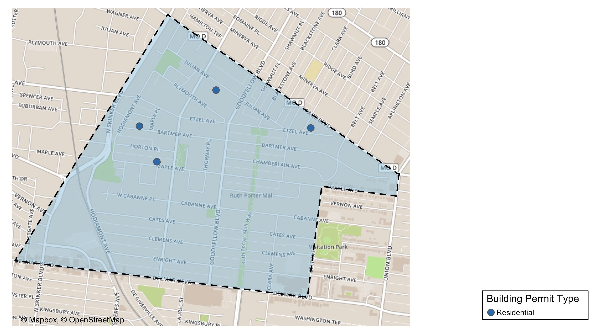
West End

Slide 31
West End
June 2020 | June 2020 | June 2020 | June 2020
Permit Use | Average Cost | # of Permits | Total Value of Permits
Commercial | $0 | 0 | $0
Industrial | $0 | 0 | $0
Institutional | $0 | 0 | $0
Residential | $99,000 | 5 | $495,000
Last 6 Months | Last 6 Months | Last 6 Months | Last 6 Months
Permit Use | Average Cost | # of Permits | Total Value of Permits
Commercial | $73,758 | 6 | $442,550
Industrial | $0 | 0 | $0
Institutional | $3,228,000 | 3 | $9,684,000
Residential | $471,764 | 25 | $11,794,096

Slide 32
West End Individual Permit Breakdown
Owner | New Use | Cost | Address
DENT, MICHAEL J SR | Residential | $8,000 | 5561-63 ETZEL AV
PEEBLES, COURTNEY & DEBORAH A & SCO | Residential | $130,000 | 6021 BARTMER AV
MABS LLC | Residential | $14,000 | 5931 MAPLE AV
WILLIAMS, LUCRETIA | Residential | $18,000 | 5872 JULIAN AV
MABS LLC | Residential | $325,000 | 5931 MAPLE AV

Slide 33
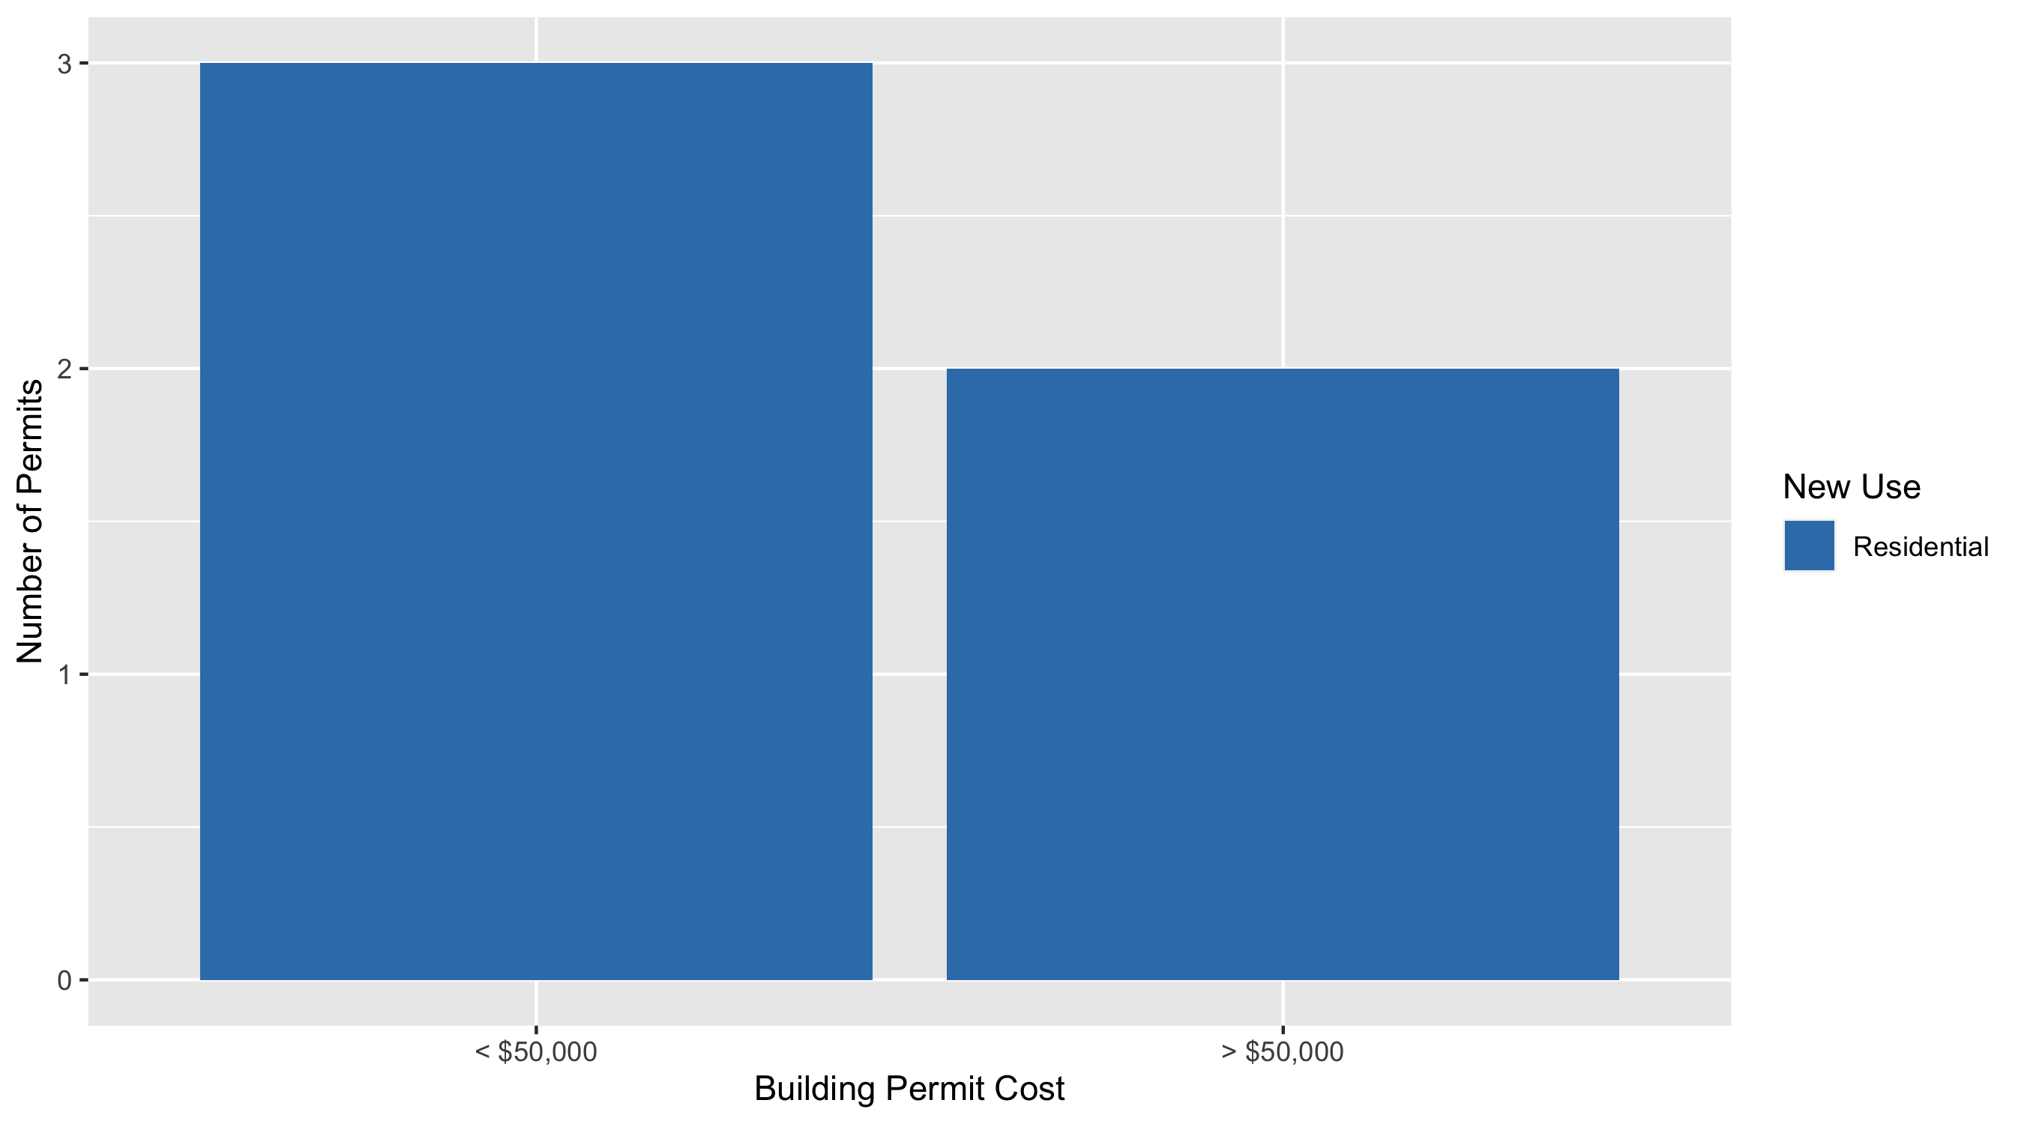
West End Permit Cost Breakdown

Slide 34
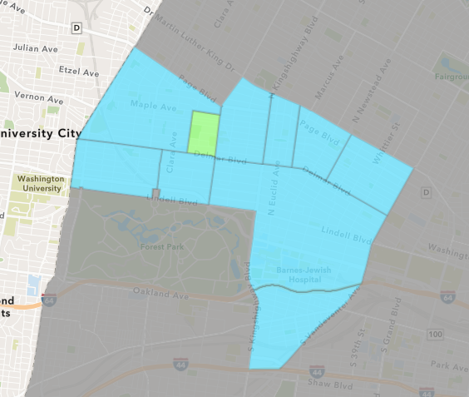
Visitation Park
June 2020 Neighborhood Cost Breakdown
Mean: $6,756
Median: $6,756
Range: $6,261 - $7,250

Slide 35
Visitation Park: Summary Notes
2 building permits in June 2020
Infinite change compared to June 2019 (0 total building permits)
$6,756: Average building permit cost in June 2020
Infinite change compared to June 2019 ($0)
3 total building permits in 2020
Infinite change YTD compared to this time in 2019 (0 total building permits)
$9,170: YTD average building permit cost in 2020
Infinite change YTD compared to this time in 2019 ($0)

Slide 36
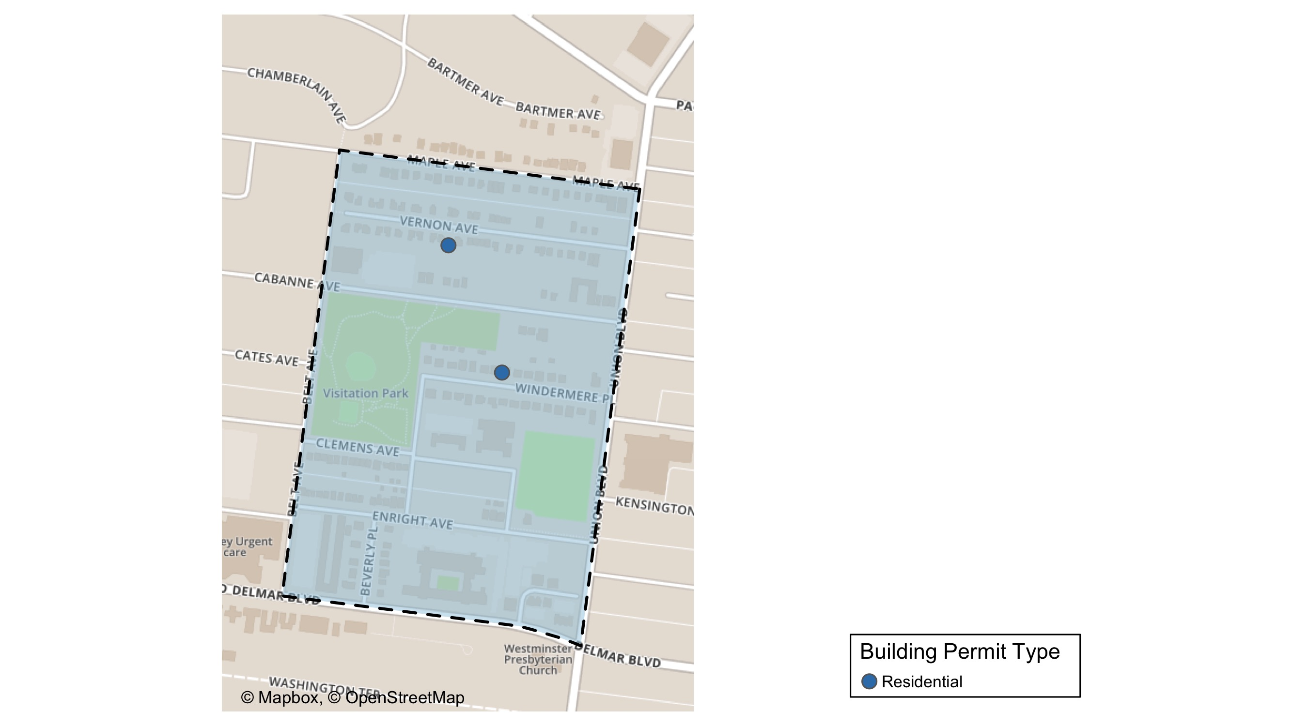
Visitation Park

Slide 37
Visitation Park
June 2020 | June 2020 | June 2020 | June 2020
Permit Use | Average Cost | # of Permits | Total Value of Permits
Commercial | $0 | 0 | $0
Industrial | $0 | 0 | $0
Institutional | $0 | 0 | $0
Residential | $6,756 | 2 | $13,511
Last 6 Months | Last 6 Months | Last 6 Months | Last 6 Months
Permit Use | Average Cost | # of Permits | Total Value of Permits
Commercial | $0 | 0 | $0
Industrial | $0 | 0 | $0
Institutional | $0 | 0 | $0
Residential | $9,170 | 3 | $27,511

Slide 38
Visitation Park Individual Permit Breakdown
Owner | New Use | Cost | Address
BOHANNON, ANTHONY | Residential | $7,250 | 5436 VERNON AV
MONTGOMERY, JUDY TRS | Residential | $6,261 | 13 WINDERMERE PL

Slide 39
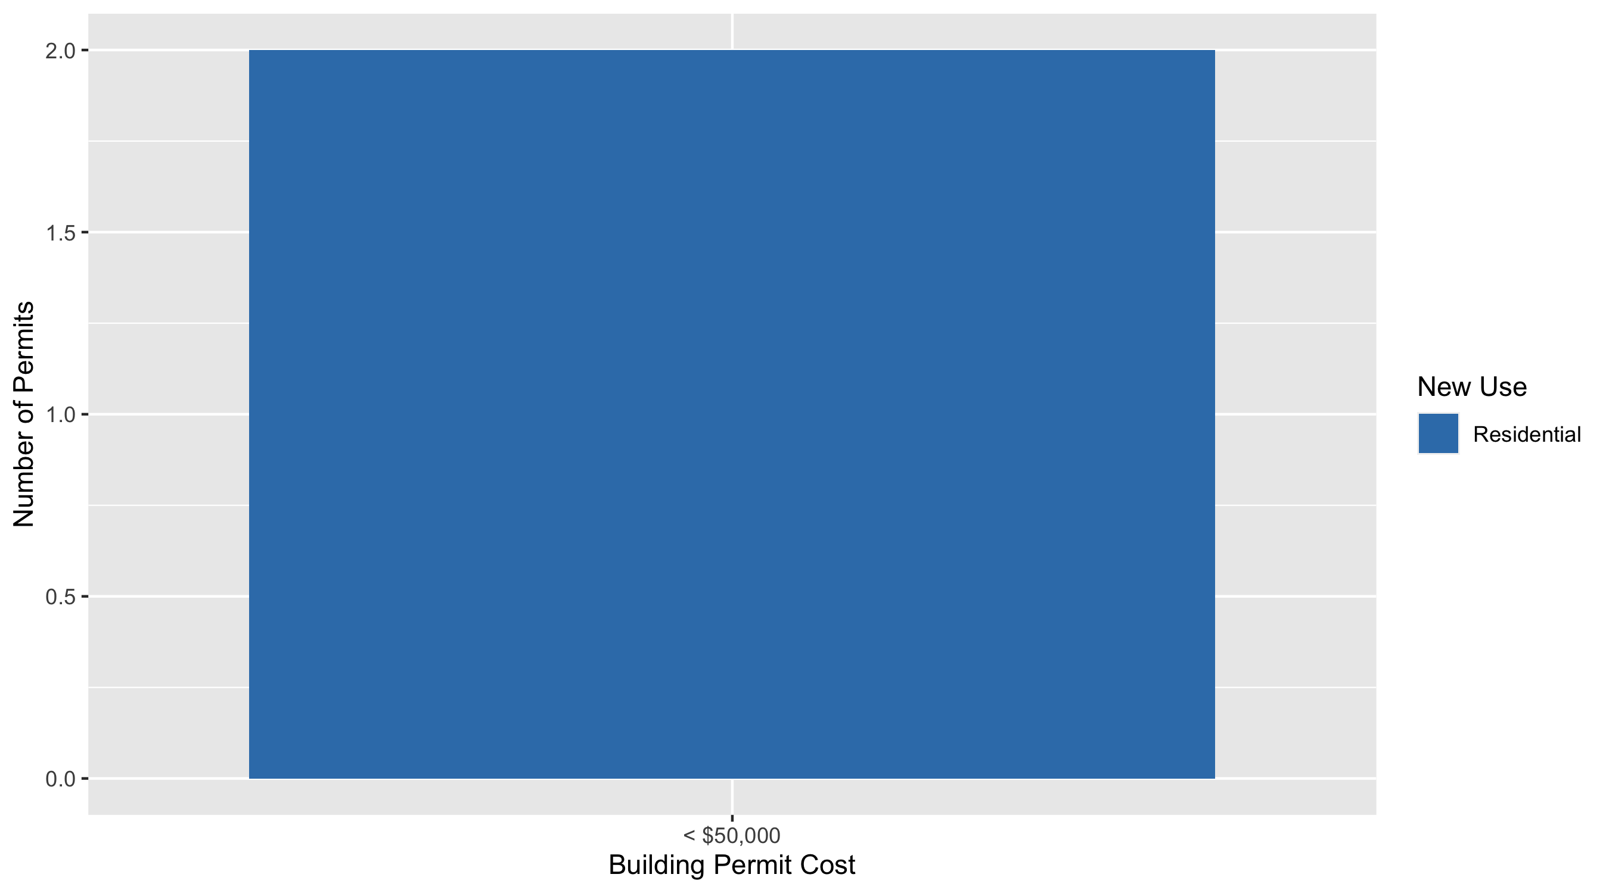
Visitation Park Permit Cost Breakdown

Slide 40
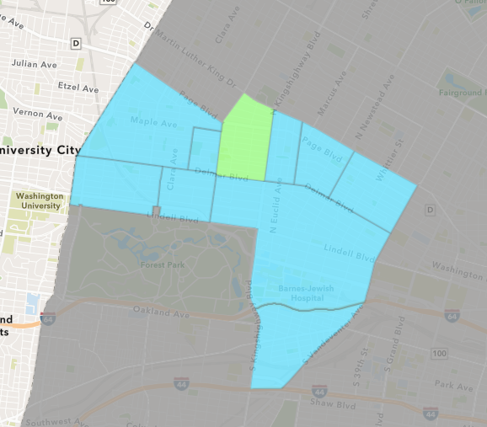
Academy
June 2020 Neighborhood Cost Breakdown
Mean: $16,967
Median: $3,000
Range: $700 - $80,000

Slide 41
Academy: Summary Notes
9 building permits in June 2020
350.00% change compared to June 2019 (2 total building permits)
$16,967: Average building permit cost in June 2020
-78.11% change compared to June 2019 ($77,500)
23 total building permits in 2020
27.78% change YTD compared to this time in 2019 (18 total building permits)
$53,037: YTD average building permit cost in 2020
-18.56% change YTD compared to this time in 2019 ($65,122)

Slide 42
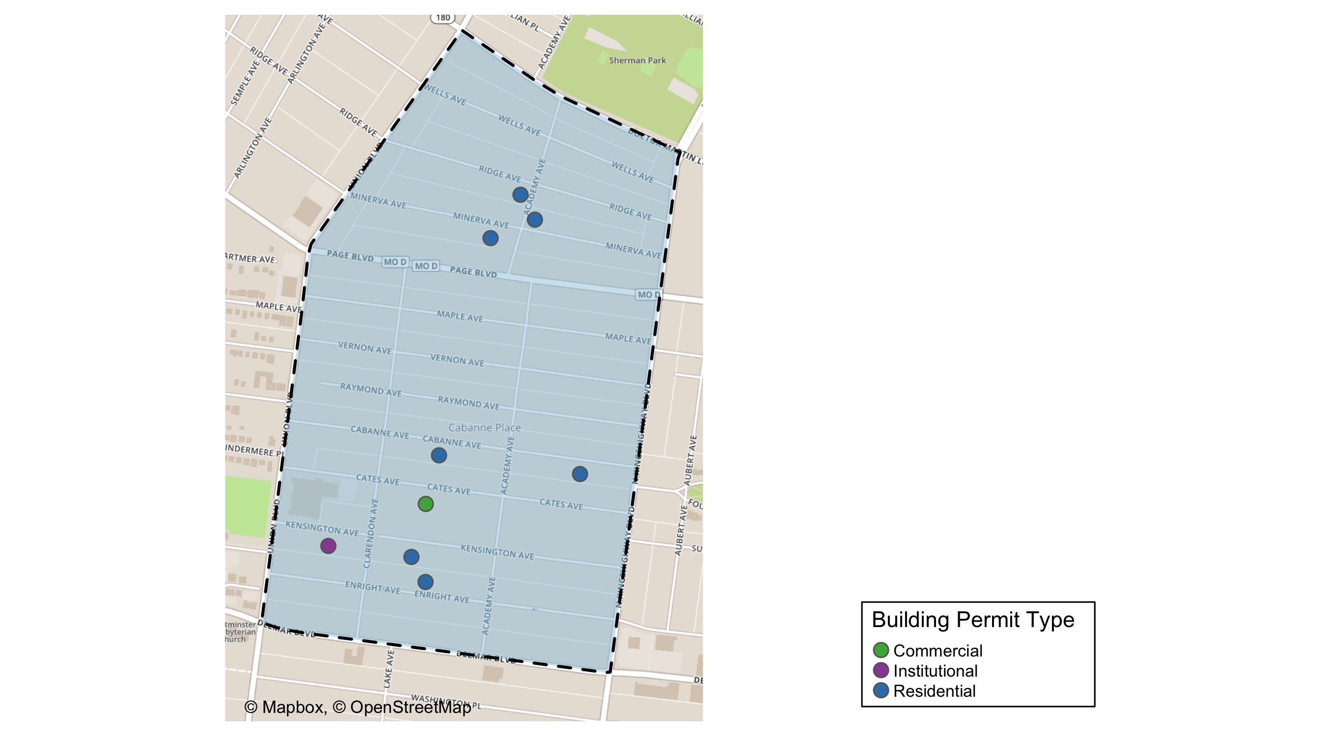
Academy

Slide 43
Academy
June 2020 | June 2020 | June 2020 | June 2020
Permit Use | Average Cost | # of Permits | Total Value of Permits
Commercial | $10,000 | 1 | $10,000
Industrial | $0 | 0 | $0
Institutional | $50,000 | 1 | $50,000
Residential | $13,243 | 7 | $92,700
Last 6 Months | Last 6 Months | Last 6 Months | Last 6 Months
Permit Use | Average Cost | # of Permits | Total Value of Permits
Commercial | $10,000 | 1 | $10,000
Industrial | $0 | 0 | $0
Institutional | $75,000 | 2 | $150,000
Residential | $52,992 | 20 | $1,059,850

Slide 44
Academy Individual Permit Breakdown
Owner | New Use | Cost | Address
CHRISTIAN, MARJORIE P & JOANN C | Residential | $3,500 | 5088 CABANNE AV
HOLLINSHED, VANESSA | Residential | $2,500 | 5179 KENSINGTON AV
SYKES, DARLENE | Residential | $2,250 | 5093 MINERVA AV
LOTT, TAMMY | Institutional | $50,000 | 5201 DELMAR BLVD
BENFORD, ERIC L SR & RAHMINA BENFORD | Residential | $750 | 5128 MINERVA AV
SHIELDS, JANELLE J | Residential | $80,000 | 5079 CATES AV
GREEN LINE LLC | Residential | $3,000 | 5105 ENRIGHT AV
STONE, JEROME & FELICIA | Residential | $700 | 5120 RIDGE AV
BINGHAM, JEFFREY | Commercial | $10,000 | 5179 CATES AV

Slide 45
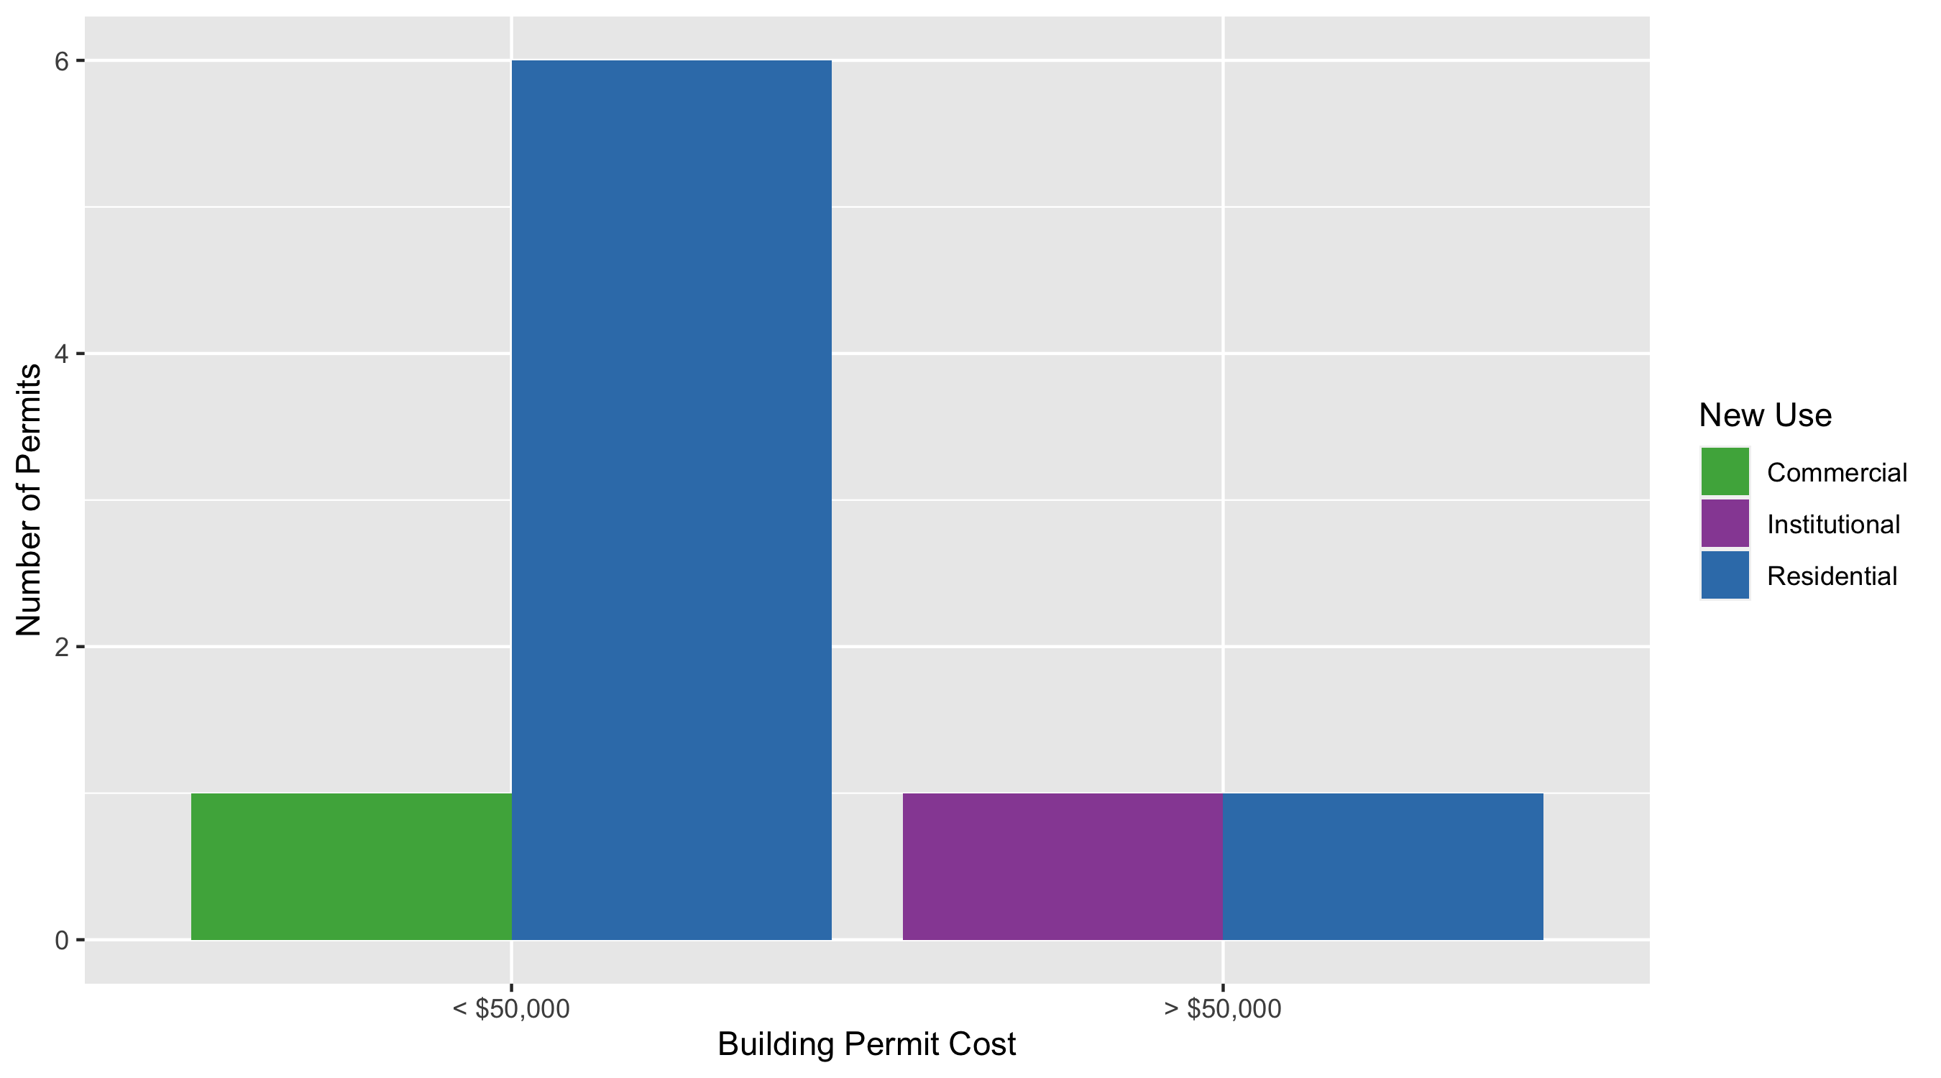
Academy Permit Cost Breakdown

Slide 46
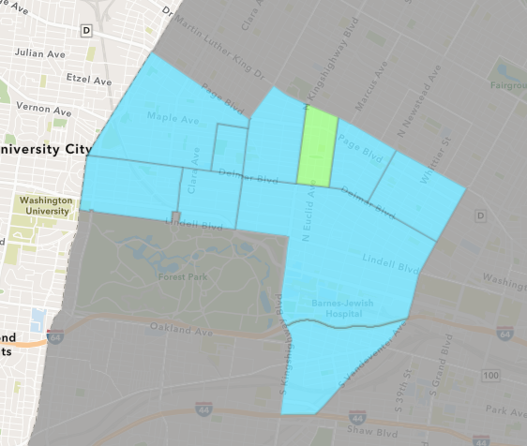
Fountain Park
June 2020 Neighborhood Cost Breakdown
Mean: $47,500
Median: $47,500
Range: $10,000 - $85,000

Slide 47
Fountain Park: Summary Notes
2 building permits in June 2020
0.00% change compared to June 2019 (2 total building permits)
$47,500: Average building permit cost in June 2020
-28.03% change compared to June 2019 ($66,000)
7 total building permits in 2020
75.00% change YTD compared to this time in 2019 (4 total building permits)
$58,357: YTD average building permit cost in 2020
74.85% change YTD compared to this time in 2019 ($33,375)

Slide 48
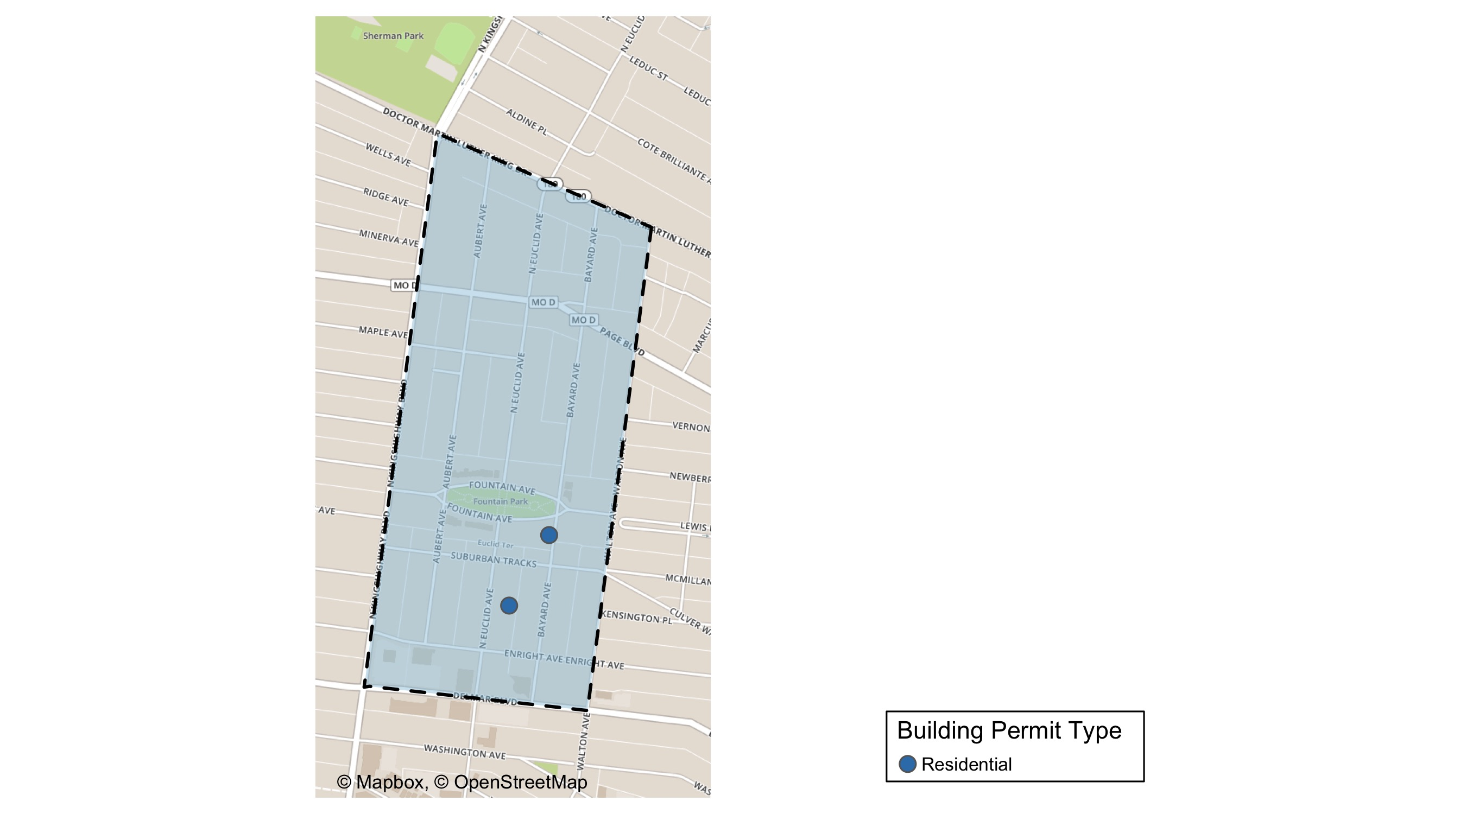
Fountain Park

Slide 49
Fountain Park
June 2020 | June 2020 | June 2020 | June 2020
Permit Use | Average Cost | # of Permits | Total Value of Permits
Commercial | $0 | 0 | $0
Industrial | $0 | 0 | $0
Institutional | $0 | 0 | $0
Residential | $47,500 | 2 | $95,000
Last 6 Months | Last 6 Months | Last 6 Months | Last 6 Months
Permit Use | Average Cost | # of Permits | Total Value of Permits
Commercial | $0 | 0 | $0
Industrial | $0 | 0 | $0
Institutional | $0 | 0 | $0
Residential | $58,357 | 7 | $408,500

Slide 50
Fountain Park Individual Permit Breakdown
Owner | New Use | Cost | Address
KINGSWAY DEVELOPMENT, LLC | Residential | $85,000 | 4852 FOUNTAIN AV
HUNT, VANESSA C | Residential | $10,000 | 764 N EUCLID AV

Slide 51
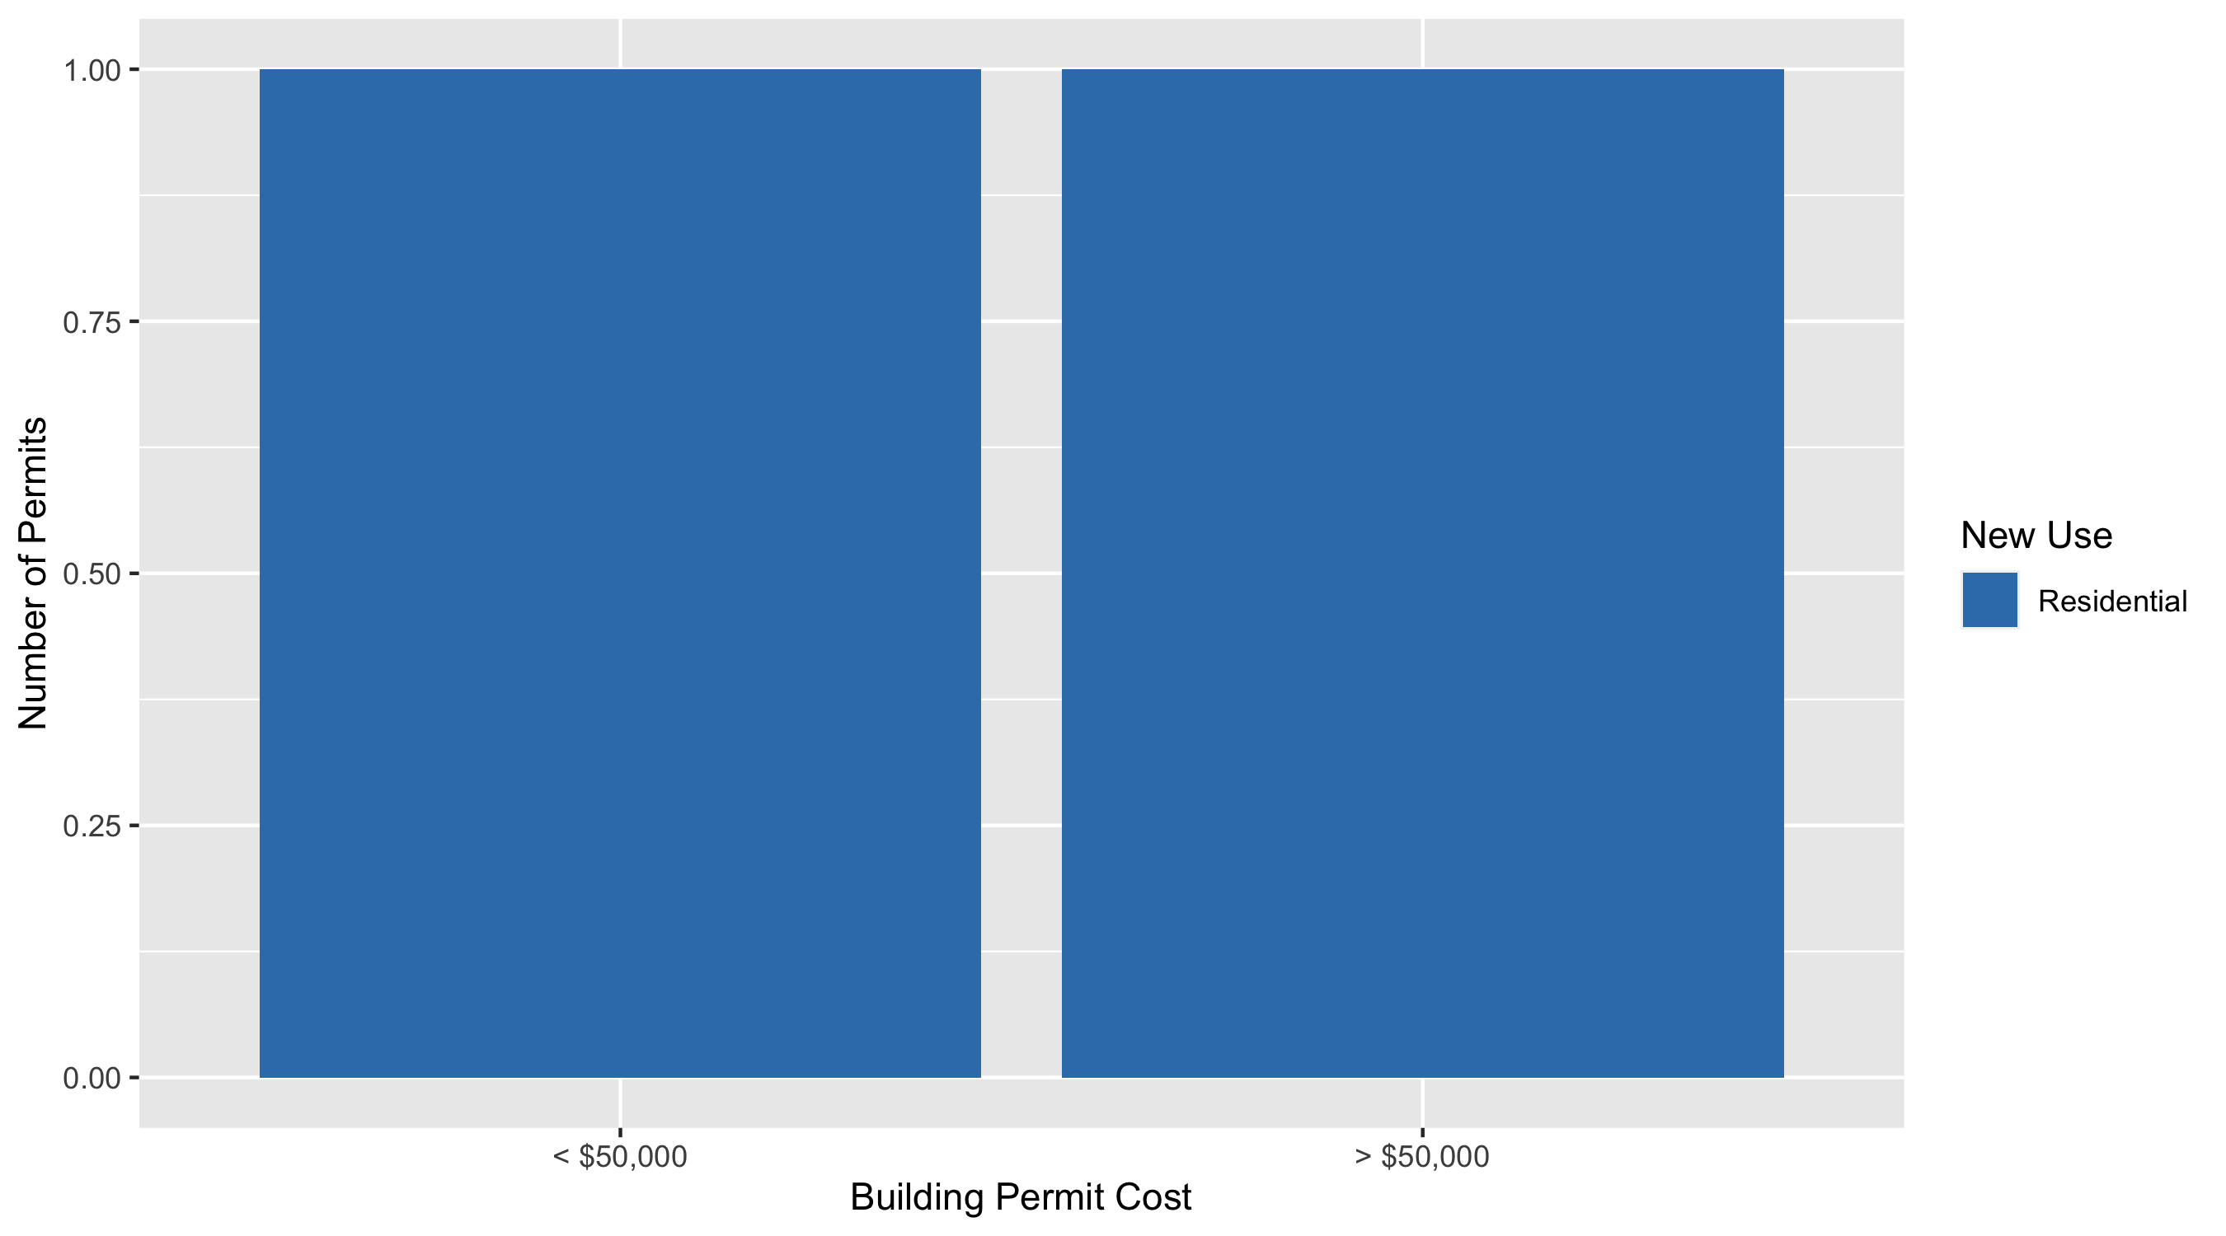
Fountain Park Permit Cost Breakdown

Slide 52
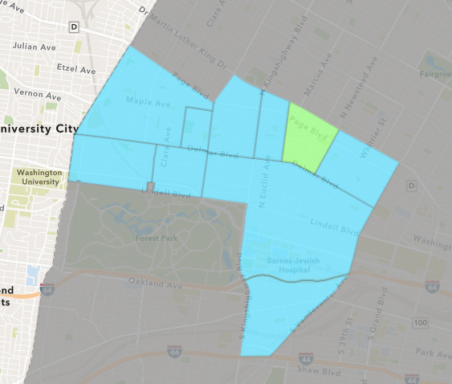
Lewis Place
June 2020 Neighborhood Cost Breakdown
Mean: $0
Median: NA
Range: $0 - $0

Slide 53
Lewis Place: Summary Notes
0 building permits in June 2020
0.00% change compared to June 2019 (0 total building permits)
$0: Average building permit cost in June 2020
0.00% change compared to June 2019 ($0)
4 total building permits in 2020
-33.33% change YTD compared to this time in 2019 (6 total building permits)
$800: YTD average building permit cost in 2020
-88.32% change YTD compared to this time in 2019 ($6,850)

Slide 54
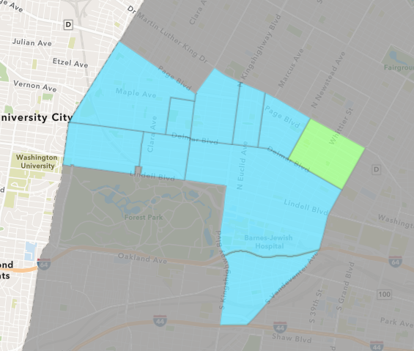
Vandeventer
June 2020 Neighborhood Cost Breakdown
Mean: $72,500
Median: $72,500
Range: $20,000 - $125,000

Slide 55
Vandeventer: Summary Notes
2 building permits in June 2020
0.00% change compared to June 2019 (2 total building permits)
$72,500: Average building permit cost in June 2020
625.00% change compared to June 2019 ($10,000)
8 total building permits in 2020
-57.89% change YTD compared to this time in 2019 (19 total building permits)
$48,135: YTD average building permit cost in 2020
-70.03% change YTD compared to this time in 2019 ($160,603)

Slide 56
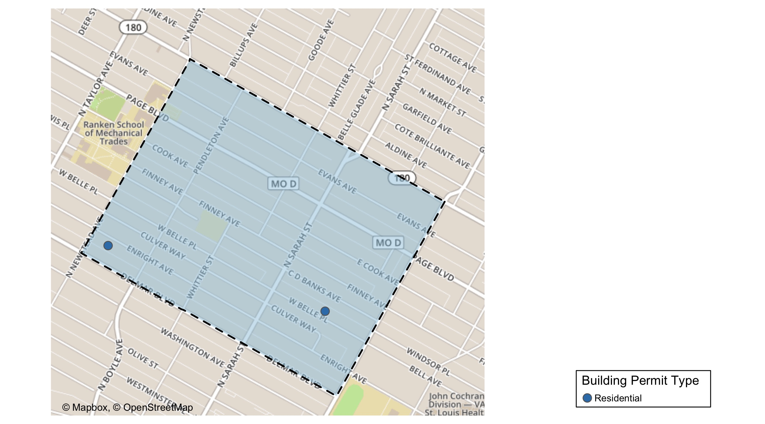
Vandeventer

Slide 57
Vandeventer
June 2020 | June 2020 | June 2020 | June 2020
Permit Use | Average Cost | # of Permits | Total Value of Permits
Commercial | $0 | 0 | $0
Industrial | $0 | 0 | $0
Institutional | $0 | 0 | $0
Residential | $72,500 | 2 | $145,000
Last 6 Months | Last 6 Months | Last 6 Months | Last 6 Months
Permit Use | Average Cost | # of Permits | Total Value of Permits
Commercial | $0 | 0 | $0
Industrial | $55,000 | 1 | $55,000
Institutional | $12,073 | 2 | $24,146
Residential | $61,186 | 5 | $305,931

Slide 58
Vandeventer Individual Permit Breakdown
Owner | New Use | Cost | Address
ALEXSAW HOLDINGS LLC | Residential | $20,000 | 4339 ENRIGHT AV
VANDEVENTER ESTATES PHASE I LLC | Residential | $125,000 | 3920 C D BANKS AV

Slide 59
Vandeventer Permit Cost Breakdown

Slide 60
Additional Notes
Data retreived from https://www.stlouis-mo.gov/data/
Building permits with a cost of $0 were dropped
Building permits that were cancelled were dropped
Infinite change indicates 0 permits in the current or previous time period/comparison month so there was a overall increase or decrease

